Slide 1


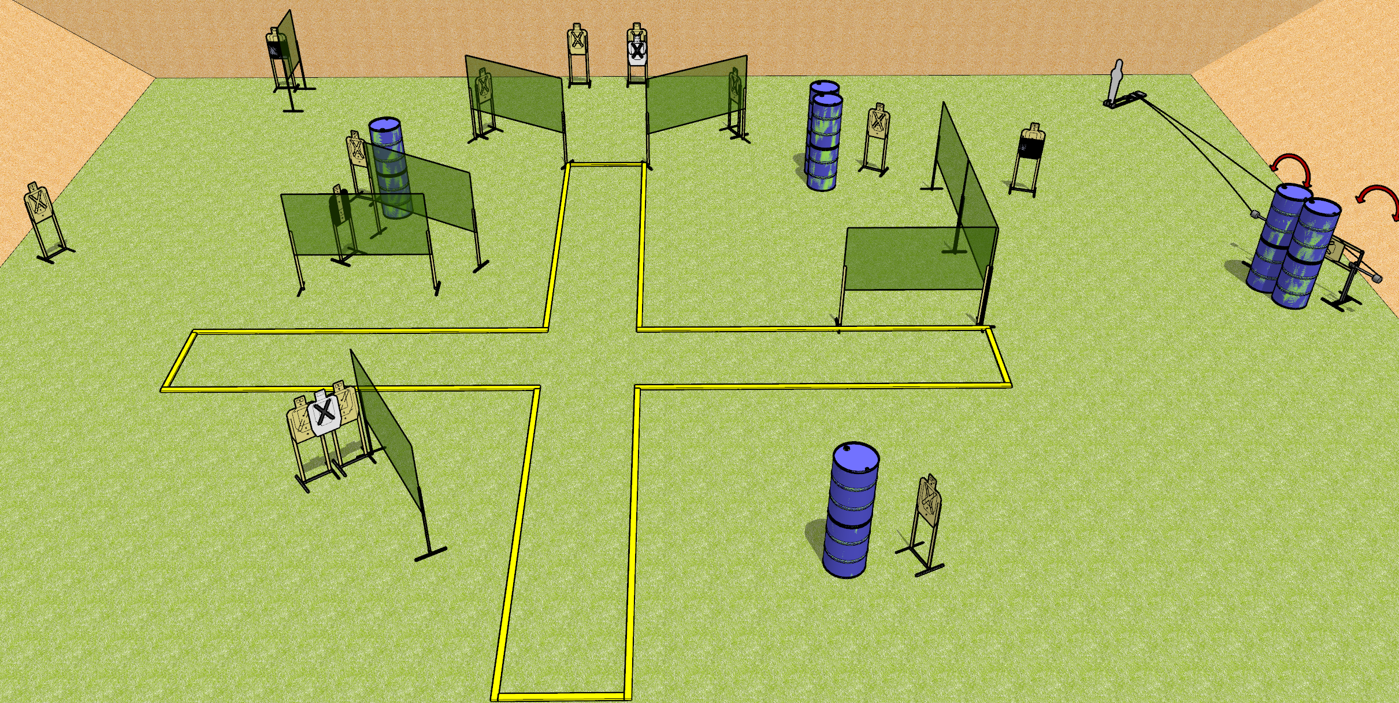
 | Dothan Gun Club – USPSA Match Plus Sized Course Designer : Drew Coleman
START POSITION : Standing anywhere inside the shooting area, wrists below belt
GUN READY CONDITION : Pistol loaded and holstered. PCC loaded, buttstock on belt, safety on. |  | SCORING: Comstock, 31 rounds TARGETS: 15 paper, 1 Steel SCORED HITS: Best 2 on paper, steel until down START-STOP: Audible, last shot RULES:
STAGE PROCEDURE: Engage targets as they become available from within the fault lines.

Slide 2
Plus Sized
Written Stage Briefing
Plus Sized is a 31 round, 155 point, Comstock field course. There are fifteen USPSA targets and one pepper popper. The best two hits on paper will score, and steel must fall to score. The start signal is audible.
Swinging targets one and two are activated by pepper popper one.
Handgun start position is standing anywhere inside the shooting area, wrists below belt. Handgun is loaded and holstered.
PCC start position is standing anywhere inside the shooting area. Loaded carbine is held with both hands, safety one, buttstock on belt.
On start signal, engage targets as they become available from within the shooting area.

